Slide 1
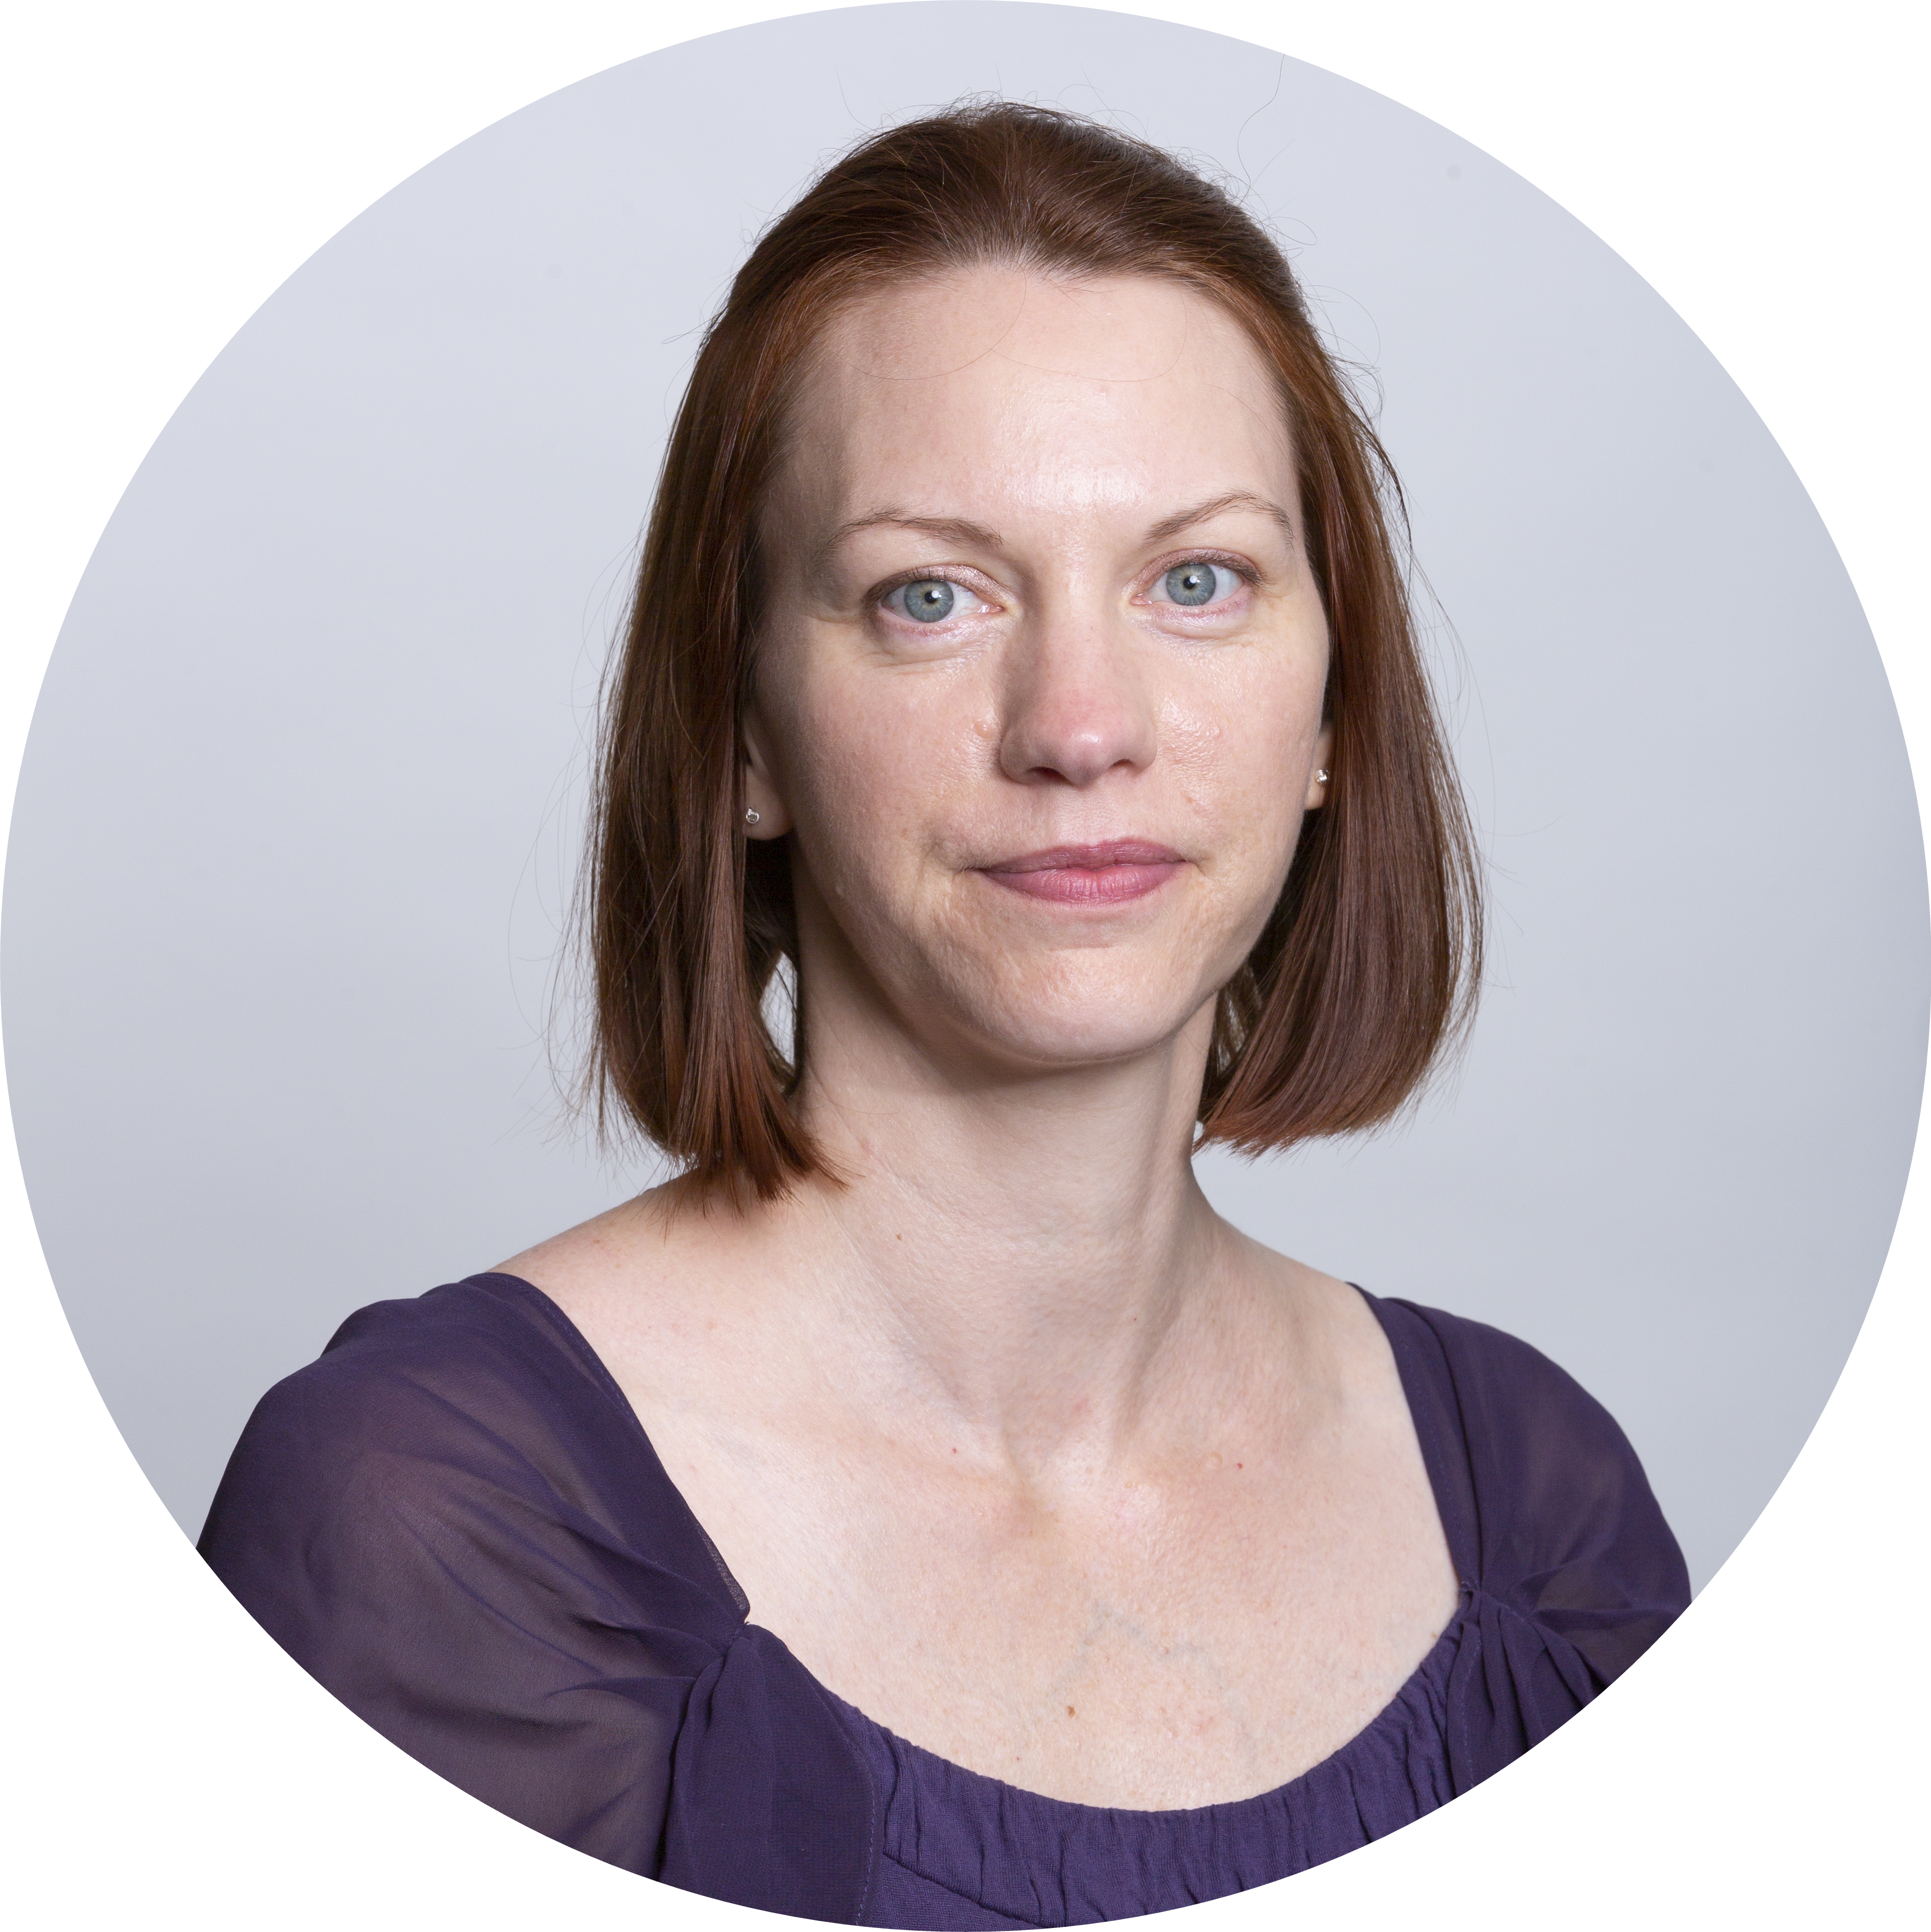
About Tonya Cooper
Hobbies
Career
Family
Notes:
Hi, my name is Tonya Cooper. I’m going to tell you a little about myself – My family, hobbies and career.

Slide 2
The Basics
Notes:
First, some basic information

Slide 3
The Basics
39 years old

Slide 4
The Basics
From
Kent City, MI
39 years old

Slide 5
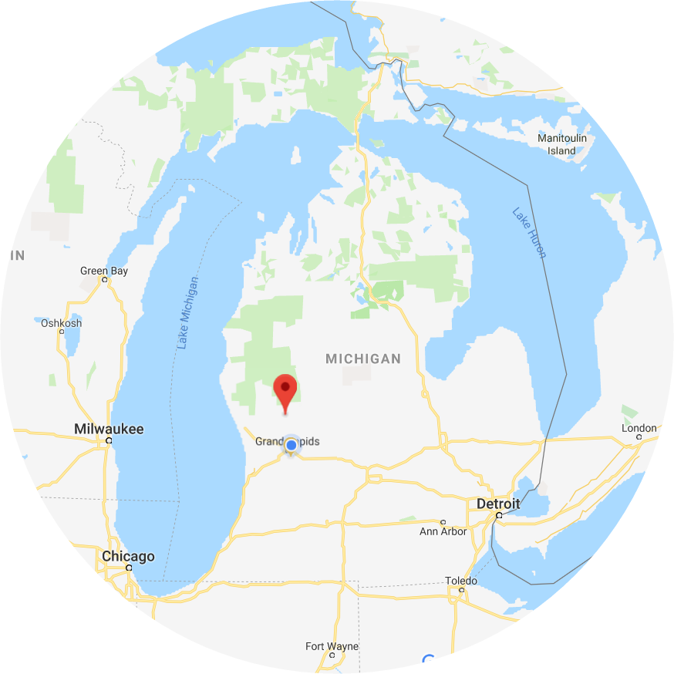

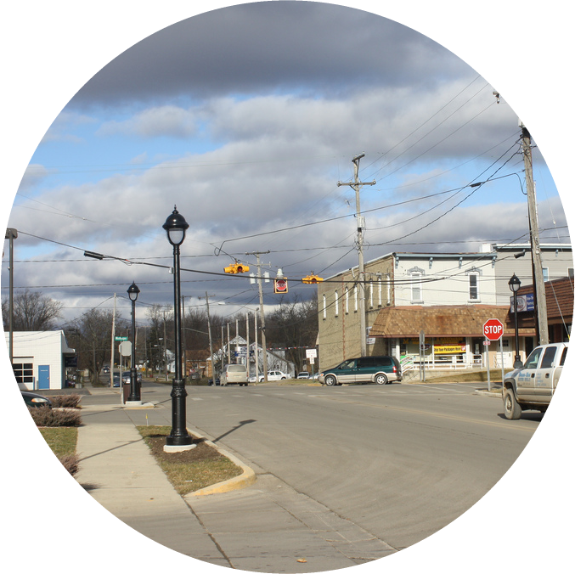
Median income
Males: $33,750 Females: $24,167
Named for James Kent
Population 1,022
Notes:
If you don’t know where that is, here it is. It is a tiny town, with one blinking stop light. When I left in 1997, the population was just over 1,000.

Slide 6
The Basics
From
Kent City, MI
Live
Grand Rapids, MI
39 years old
Notes:
Now I live in Grand Rapids, MI

Slide 7



Median income
Males: $33,750 Females: $24,167
Furniture City
Beer City
ArtPrize
Population 198,000
Notes:
Which is just south of where I grew up. It’s quite a bit larger with a population of 198,000. It’s also known as Furniture City and Beer City, USA. It’s known for ArtPrize, which is an international art contest held in the city.

Slide 8
About Tonya Cooper
Hobbies
Career
Family

Slide 9
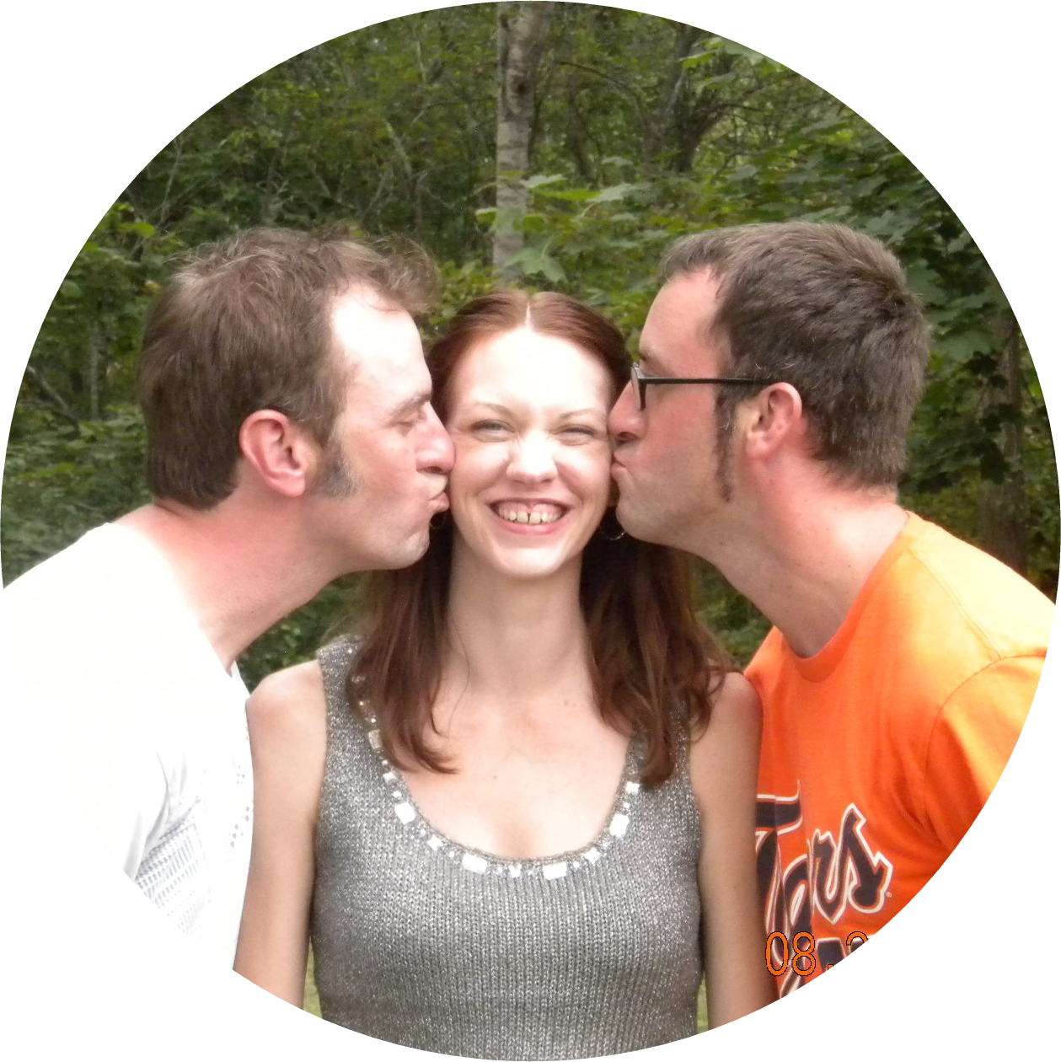
My People
Family
Notes:
I am the middle child between two brothers.

Slide 10
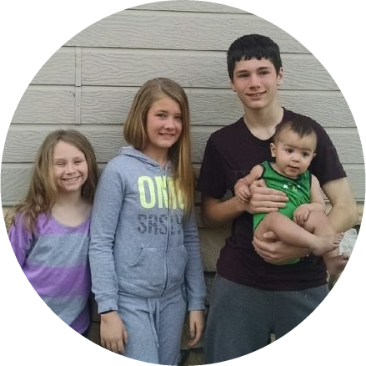
My People
Family
Notes:
I have two nieces and two nephews.

Slide 11
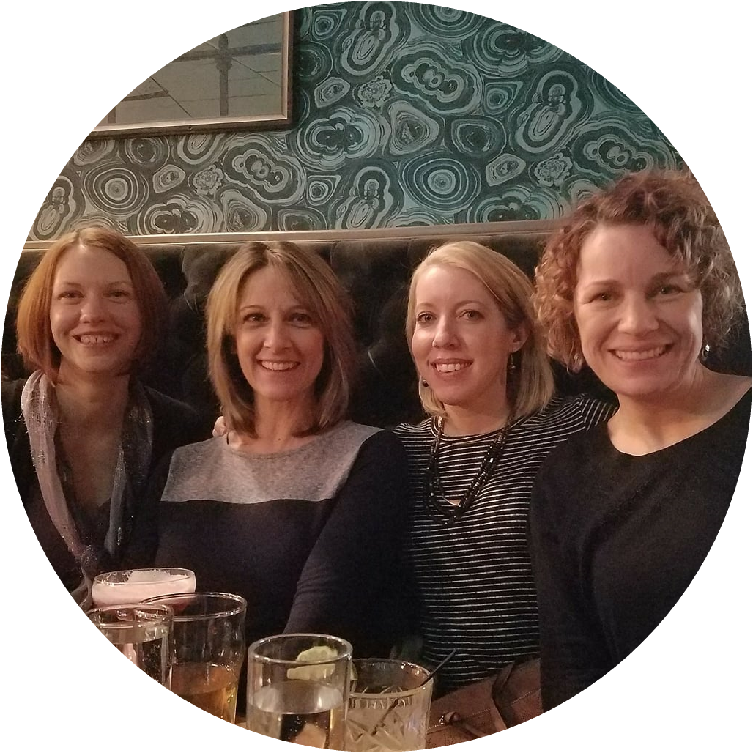
My People
Family

Slide 12
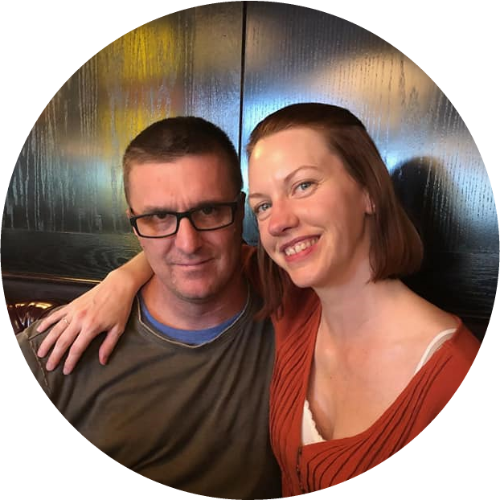
My People
Family
Notes:
I have a lot of friends and family in Grand Rapids, and I don’t have any children or pets – so basically I don’t have any responsibilities and I’m often out finding trouble with friends.

Slide 13
About Tonya Cooper
Hobbies
Career
Family

Slide 14
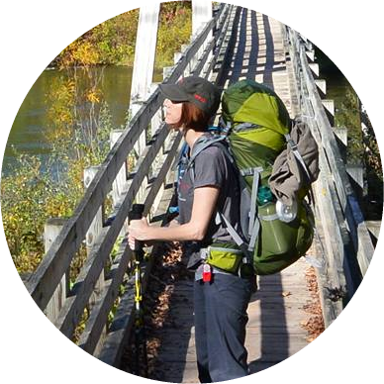
Things I love to do
Hobbies
Notes:
I suppose my newest hobby is backpacking, but I’ve always enjoyed hiking, and have hiked in the Rocky Mountains, Tetons and Superstition Mountains, but I also enjoy hiking and backpacking here in Michigan.

Slide 15
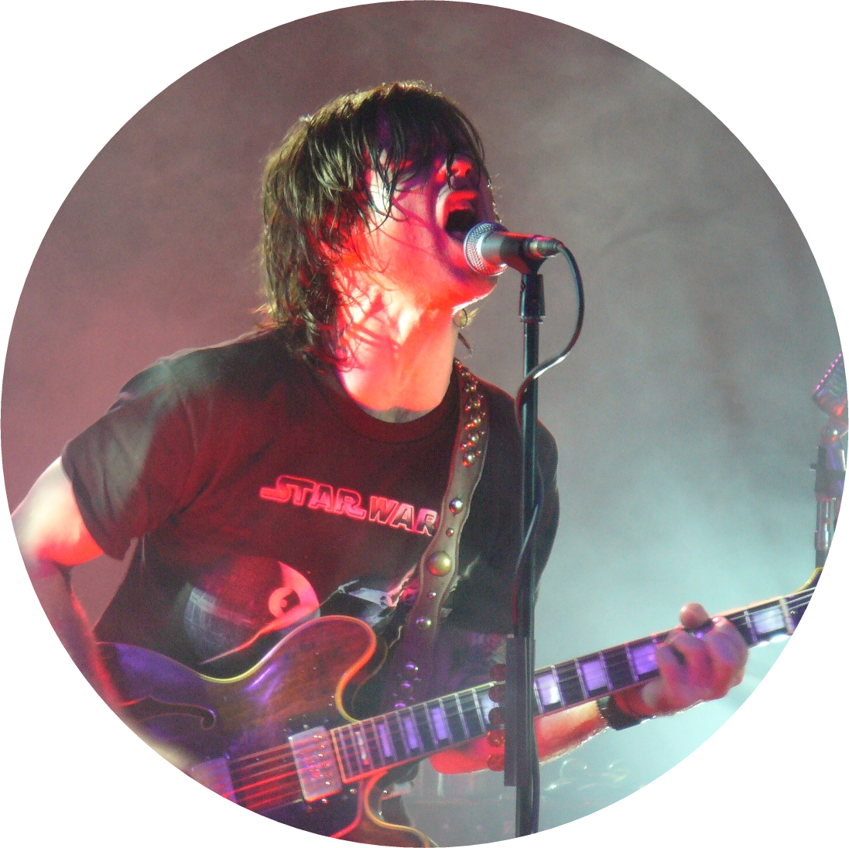
Things I love to do
Hobbies
Notes:
I love music – seeing it live, or just listening at home. I have a couple guitars and I’m working on getting better at guitar.

Slide 16

Things I love to do
Hobbies
Notes:
I like to travel and experience new cities, make new friends and hike new areas.

Slide 17
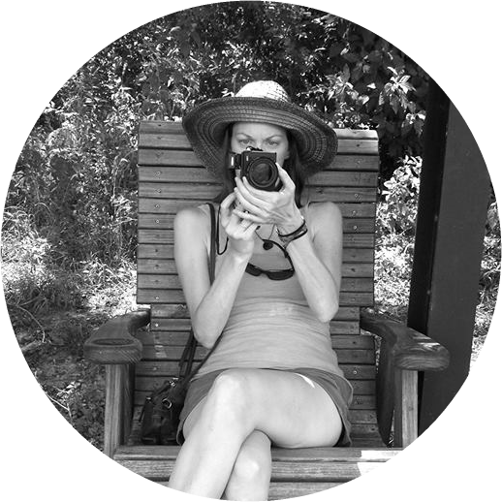
Things I love to do
Hobbies
Notes:
I used to run a photography business on the side – senior pictures, weddings, family portraits. Now I just take pictures for fun and incorporate that into my travels.

Slide 18
About Tonya Cooper
Hobbies
Career
Family

Slide 19
About Tonya Cooper
Quicken Loans
Software
Engineer
Career
Conferences
Notes:
I’ve been a software engineer for 7 years. I have been with Quicken for a year on January 2.. So far the journey here has been amazing. When I began my career as a software developer, I was lucky to have an excellent Team Leader who advocated for the developers to be able to attend conferences. We typically attended two a year. Being exposed to both the community and the wealth of knowledge early in my career had a big impact on me. I’m at this workshop because I want to give back to the community and share the things I’ve learned on my journey that will help accelerate someone else’s career.

Slide 20
Thank you!

